Slide 1

Development Across the Life Span
Eighth Edition
Chapter 14
Social and Personality Development in Early Adulthood
Copyright © 2017, 2014, 2011 Pearson Education, Inc. All Rights Reserved
Notes:
If this PowerPoint presentation contains mathematical equations, you may need to check that your computer has the following installed:
1) MathType Plugin
2) Math Player (free versions available)
3) NVDA Reader (free versions available)

Slide 2
Learning Objectives (1 of 3)
14.1 Summarize what makes young adults happy and what is meant by the social clock.
14.2 Explain how young adults respond to the need for intimacy and friendship and how liking turns to loving.
14.3 Differentiate the different kinds of love
14.4 Describe how young adults choose spouses.
14.5 Explain how infant attachment styles are related to romantic relationships as adults.

Slide 3
Learning Objectives (2 of 3)
14.6 Describe the sorts of relationships people enter into in early adulthood and what makes these relationships work or cease to work.
14.7 Describe how the arrival of children affects a relationship in early adulthood.
14.8 Compare gay and lesbian parents to heterosexual parents.
14.9 Explain why some people choose to remain single in early adulthood.

Slide 4
Learning Objectives (3 of 3)
14.10 Explain the role of careers in the lives of young adults.
14.11 List factors that influence the choice of a career in early adulthood.
14.12 Describe how gender affects work choices and the work environment.
14.13 Explain why people work and what elements of a job bring satisfaction.

Slide 5
Developmental Tasks of Adulthood
Adulthood (Ages 20 to 40) | Middle Adulthood (Ages 40 to 60) | Late Adulthood (Ages 60+)
Taking responsibility for yourself Understanding that you have a unique history and that it is not permanent Managing the separation from your parents Redefining the relationship with your parents Gaining and interpreting your sexual experiences Becoming capable of intimacy with another (non-family) person Managing money Developing skills that can lead to a career Considering career possibilities Considering parenthood and possibly becoming a parent Defining your values Finding a place in society | Understanding that time is passing and accepting it Accepting that you are aging Accepting changes in your body, including appearance and health Developing an acceptable work identity Becoming a member of society Understanding that society is constantly changing Keeping old friends and making new ones Coping with changes in your sexuality Continuously reworking your spousal or partner relationship Altering your relationship with your children as they age Passing on knowledge, skills, and values to the next generation Managing money effectively for short and long-term goals Experiencing the illness and death of persons close to you, especially parents Finding a place in society | Spending time well Remaining social rather than isolated Making friends and new connections Adjusting to changing sexuality Staying healthy Managing physical pain, ailments, and limitations Making life without work a comfortable lifestyle Using time wisely for engaging work and recreation Managing finances effectively for yourself and your dependents Focusing on the present and future, not dwelling on the past Adjusting to ongoing losses of close connections Accepting care from children and grandchildren

Slide 6
Forging Relationships: Intimacy, Liking, and Loving During Early Adulthood
14.1 Summarize what makes young adults happy and what is meant by the social clock.
14.2 Explain how young adults respond to the need for intimacy and friendship and how liking turns to loving.
14.3 Differentiate the different kinds of love
14.4 Describe how young adults choose spouses.
14.5 Explain how infant attachment styles are related to romantic relationships as adults.

Slide 7
The Components of Happiness
Happiest memories: psychological needs rather than material needs satisfied
Unhappiest memories: basic psychological needs left unfulfilled
Culture influences which psychological needs are most important in determining happiness
Notes:
According to research on young adults, happiness usually is derived from feelings of independence, competence, self-esteem, or relating well to other people.

Slide 8
The Social Clocks of Adulthood
Recording the major milestones of life
Culturally determined
Shifting cultural landscape means that the timing of major events is also changing
Women may especially show variability in their choice of “clocks” and the timing of each
Notes:
Social Clock is psychological timepiece that records the major milestones in our lives.
Social clocks are culturally determined.
Ravenna Helson
Found broad patterns of women's social clocks by studying them at the ages of 21, 27, and 43.
She found that women became more self-displayed and committed over the years.
They felt greater independence and confidence and could cope with stress more effectively.
Many women exhibit traditional feminine behavior from age 21 to 27, finding a spouse, becoming mothers.
As children grew up, women took on less traditional roles.
Women tend to change positively over time.
Helson concluded that the social clock one chooses is not as important as the process of choosing.

Slide 9
Seeking Intimacy: Erikson’s View of Young Adulthood
Intimacy-versus-isolation stage
Intimacy: Close, intimate relationship with others
Isolation: Feelings of loneliness and fearful of relationships
Notes:
Erikson regarded young adulthood as the time of the Intimacy-Versus-Isolation Stage.
It spans post-adolescence into the early 30s.
Focus is on developing close, intimate relationship with others.
People who experience difficulties at this stage are often lonely and fearful of relationships, perhaps from a failure of the identity stage.
Erikon’s view of healthy intimacy was limited to adult heterosexuality and the goal was to produce children, a view not shared by all developmentalists today.

Slide 10
Emerging Adulthood
Period between 18 and late 20s
May be response to shifting cultural forces; delayed onset of full adulthood
Continued growth and change in brain development
Continued identity exploration
Criticism
  Ability to spend time which is not available to everyone
  True developmental stages are not optional

Slide 11
Friendship
Most of our relationships with others involve friends, and for most people maintaining such relationships is an important part of adult life
Basic need for belonging
Influenced by proximity, similarity, and personal qualities
Although most adults claim on surveys to have a close friend of a different race, when they are queried regarding the names of close friends, few include a person of a different race

Slide 12
Passionate and Companionate Love
Researchers suggest that our love relationships can fall into two different categories
Passionate love
A state of powerful absorption in someone
Labeling theory predicts the experience of romantic love
Companionate love
The strong affection that we have for those with whom our lives are deeply involved
Notes:
Not all love is the same.
Passionate (Romantic Love) – state of powerful absorption in someone.
Companionate Love – strong affection we have for those with whom our lives are deeply involved.

Slide 13
Sternberg’s Triangular Theory:
The Three Faces of Love
Intimacy
Passion
Decision/Commitment
Notes:
Robert Sternberg says that love is made up of three components:
Intimacy
Feelings of closeness, affection, connection.
Passion
Motivational drives relating to sex, physical closeness, and romance.
Decision/Commitment
Thoughts of love and determination to maintain that love.
These components can be combined to form eight different types of love depending on which of three components is either present or missing from relationship.

Slide 14
The Combinations of Love (1 of 2)
Type of Love | Intimacy | Passion | Component Decision / Commitment | Example
Nonlove | Absent | Absent | Absent | The way you might feel about the person who takes your ticket at the movies
Liking | Present | Absent | Absent | Good friends who have lunch together at least once or twice a week
Infatuated love | Absent | Present | Absent | A “fling” or short-term relationship based only on sexual attraction
Empty love | Absent | Absent | Present | An arranged marriage or a couple who have decided to stay married “for the sake of the children”

Slide 15
The Combinations of Love (2 of 2)
Type of Love | Intimacy | Passion | Component Decision / Commitment | Example
Romantic love | Present | Present | Absent | A couple who have been happily dating a few months, but have not made any plans for a future together
Companionate love | Present | Absent | Present | A couple who enjoy each other’s company and their relationship, although they no longer feel much sexual interest in each other
Fatuous love | Absent | Present | Present | A couple who decides to move in together after knowing each other for only two weeks
Consummate love | Present | Present | Present | A loving, sexually vibrant, long-term relationship

Slide 16
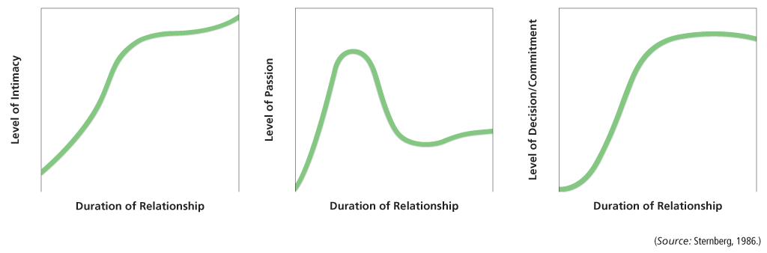
Figure 14-1 The Shape of Love
Over the course of a relationship, the three aspects of love- intimacy, passion, and decision/commitment- vary in strength. How do these change as a relationship develops?
(Source: Sternberg, 1986.)
Notes:
Over the course of a relationship, the 3 aspects of love-intimacy, passion, decision/commitment—vary in strength.
Type of love that predominates in relationship varies over time.
As shown in Figure 14-3, in strong, loving relationships the level of decision/commitment peaks and remains fairly stable.
By contrast, passion tends to peak early in relationship, but then declines and levels off.
Intimacy also increases fairly rapidly, but can continue to grow over time.

Slide 17
Seeking a Spouse: Is Love the Only Thing that Matters?
U.S. - love as a major factor
In other cultures, love may be secondary
  Emotional maturity, health, similar education, chastity
Notes:
In the U.S., people emphasize love as a major factor.
In other cultures, love may be a secondary consideration (Pakistan, India), although still relatively high on the list of important characteristics according to research.
What else matters?
Emotional maturity, health, similar education, chastity are among the top 18 in a study by Buss, 1990.
U.S.—love and mutual attraction.
China---men: good health; women: emotional stability and maturity.
South Africa/Zulu—men: emotional stability, women: dependable character.
Direct students to Table 14.3.

Slide 18
Choosing a Mate
Evolutionary perspective
Gender differences
Species requirement
Filtering model
Broad determinants of attractiveness
Specific factors act as finer “sifters”
Successive filters lead to an end result
Notes:
Gender differences in preferred characteristics exist.
Men prefer physical attraction.
Women prefer ambition, industriousness.
Why?
Psychologist David Buss points out that human beings, as a species, seek out certain characteristics to maximize beneficial genes and reproductive success (evolutionary perspective).
Critics of evolutionary approach argue that similarities across cultures relating to gender preferences reflect gender stereotyping and have nothing to do with evolution.
They say it is a rational choice for women to prefer a high earning-potential spouse and that men can afford to be concerned only with looks.
Ask: What do you think?

Slide 19
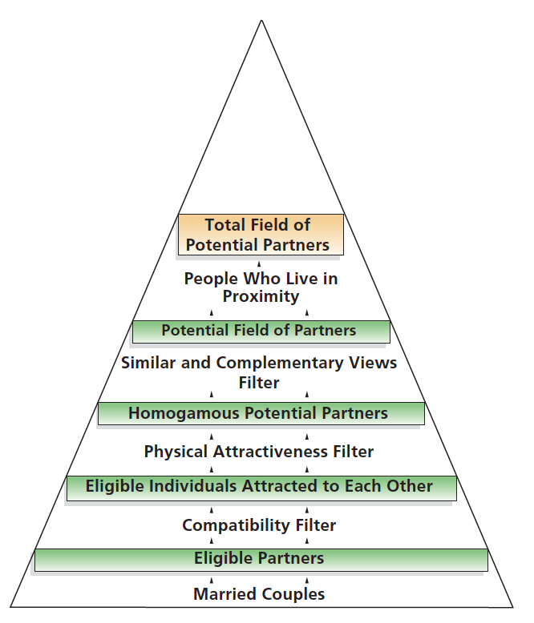
Figure 14-2 Filtering Potential Marriage Partners
According to one approach, we screen potential mates through successively finer- grained filters in order to settle on an appropriate spouse.
(Source: Based on Janda & Klenke- Hamel, 1980.)
Notes:
According to one approach, we screen potential mates
through successively finer-grained filters in order to settle on an appropriate spouse.
(Source: Based on Janda and Klenke-Hamel, 1980.)

Slide 20
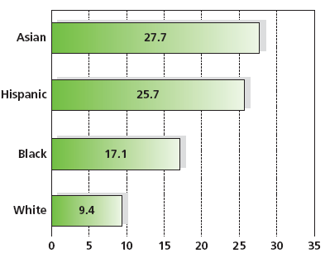
Figure 14-3 Marriage Outside of One’s Racial/Ethnic Group
Although homogamy has been the standard for most marriages in the United States, the rate of marriages crossing ethnic and racial lines is substantial.
(Source: Wang/Pew Research Center, 2012.)
Notes:
Intermarriage Rates, by Race and Ethnicity, 2010 Percent of newlyweds married to someone of a different race/ethnicity
Note: Asians include Pacic Islanders. Whites, blacks, and Asians include only non-Hispanics. Hispanics are of any race.
Although homogamy has been standard for most marriages in U.S., rate of marriages crossing ethnic/racial lines is substantial. (Source: Wang/Pew Research Center, 2012.)
The marriage gradient makes finding a spouse particularly difficult for well-educated African American women.
Fewer African American men attend college than African American women, making the potential pool of men who are suitable—as defined by society and the marriage gradient—relatively small.
Consequently, relative to women of other races, African American women are more apt to marry men who are less educated than they are—or not marry at all (Tucker and Mitchell-Kernan, 1995; Kiecolt and Fossett, 1997; Willie and Reddick, 2003).

Slide 21
Attachment Styles and Romantic Relationships
Infant attachment style is reflected in adult romantic relationships
Secure
Avoidant
Ambivalent
Notes:
Infant attachment style is reflected in adult romantic relationships (Shaver).
Secure
Happy and confident about future of their relationships (over 50%)
Avoidant
Less invested, higher break-up rates, often feel lonely (25%)
Ambivalent
Overly invested, repeated break-ups with same partner, low self-esteem (20%)
Attachment style related to nature of care adults give to their romantic partners when they need assistance.
Secure adults are more sensitive and supportive.
Anxious adults are more compulsive, intrusive.
People have relationship difficulties should look back to infant styles for insight into how to be more adaptive in adult relationships.

Slide 22
The Course of Relationships
14.6 Describe the sorts of relationships people enter into in early adulthood and what makes these relationships work or cease to work.
14.7 Describe how the arrival of children affects a relationship in early adulthood.
14.8 Compare gay and lesbian parents to heterosexual parents.
14.9 Explain why some people choose to remain single in early adulthood.

Slide 23
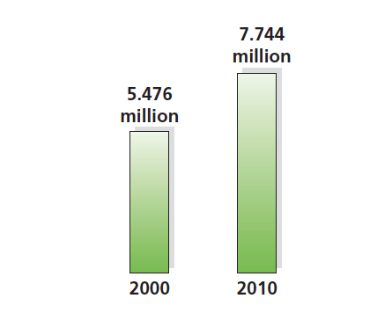
Figure 14-4 Cohabitation
The number of couples living together prior to marriage increased by 41 percent from the year 2000 to 2010.
(Source: U.S. Bureau of the Census, 2010.)
Notes:
Past three decades have seen both a decline in the number of married couples and a significant rise in couples living together without being married, a status known as cohabitation.
Married couples now make up a minority of households: as of 2005, 49.7 percent of all U.S. households contained a married couple.

Slide 24
Why Marry?
Preferred alternative during early adulthood
Desirability of spouse roles
Legitimatization of children
Legal benefits and protections
Notes:
Many see marriage as appropriate culmination of loving relationship, while others feel it is “right” thing to do after reaching particular age in early adulthood.
Spouse can play economic, sexual role, and therapeutic and recreational role.
Only means of having children that is fully accepted by all segments of society.
Marriage offers legal benefits and protections, such as being eligible for medical insurance under a spouse’s policy and eligibility for survivor benefits like Social Security benefits.

Slide 25
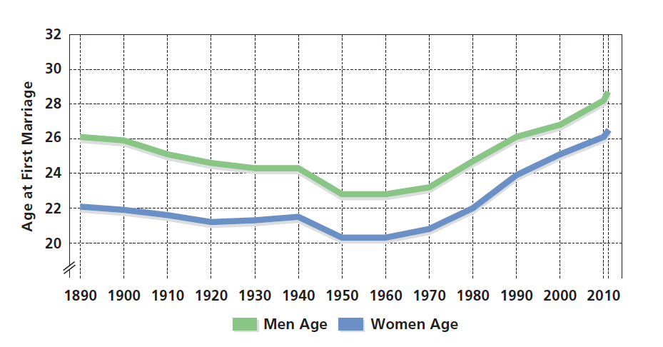
Figure 14-5 Postponing Marriage
The age at which women and men first marry is the highest since national statistics were first collected in the late 1800s. What factors account for this?
(Source: U.S. Bureau of the Census, 2011.)
Notes:
Figure 14-6 Postponing Marriage
The age at which women and men first marry is the highest since national
statistics were first collected in the late 1800s. What factors account for this?
(Source: U.S. Bureau of the Census, 2011.)
Reflects economic concerns and the commitment to establishing career.
Ask: Can you think of any other reasons?

Slide 26
What Makes Marriage Work? (1 of 2)
Successful married partners:
Show affection
Communicate relatively little negativity
Perceive themselves as interdependent
Experience social homogamy
Hold similar interests
Agree on distribution of roles

Slide 27
What Makes Marriage Work? (2 of 2)
Most married couples:
View early years of marriage as deeply satisfying
Find themselves more deeply in love than before marriage
Report newlywed period as one of happiest in entire married life

Slide 28
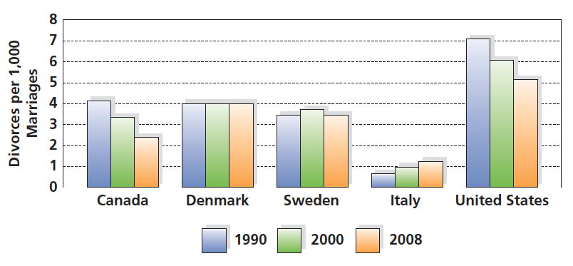
Figure 14-6 Divorce Around the World
Countries around the world have substantial divorce rates, although in some places the rate is declining.
(Source: Adapted from Population Council Report, 2009.)

Slide 29
Parenthood: Choosing to Have Children
Deciding whether to have children is one of the most important decisions couples make
Young adults typically cite psychological reasons for having children
  Vicarious reinforcement from child successes
  Care or companionship in old age
  Response to societal norm
Notes:
Some children are unplanned, but couples cope, because they wanted children eventually; some unplanned children are unwanted.
Today most families have no more than 2 children, rate in US today is 2.1 children per woman (in 1957, it was 3.7 children per woman).
Women are having children later today, into their late 30s and older.
A middle-class family with two children will spend about $233,000 for each child before the child reaches the age of 18.
People have children for psychological reasons.
Pleasure of watching them grow.
Hope children will provide for them in old age or offer companionship.
Most married couples have at least one child.
Some children are unplanned, but couples cope, because they wanted children eventually.
But some unplanned children are unwanted.
Today most families have no more than 2 children, rate in U.S. today is 2.1 children per woman.
Women are having children later today, into their late 30s and older.

Slide 30
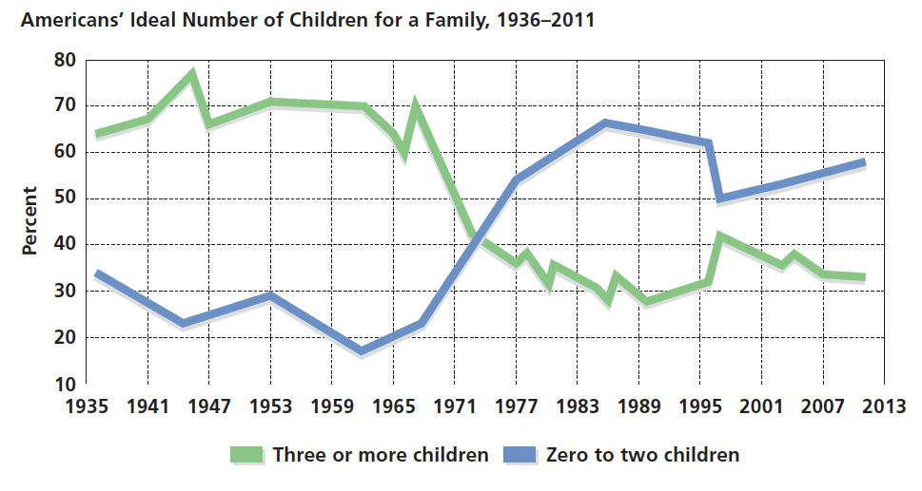
Figure 14-8 Smaller Is Better
Continuing trends over the last 75 years, U.S. parents continue to prefer families with fewer children. What do you think is the ideal number of children for a family to have?
(Source: Saad, 2011.)

Slide 31
What Produced the Decline in the U.S. Fertility Rate?
Availability of more reliable birth control methods
Increasing numbers of women working outside the home
Choosing to have children later
Cost of raising and educating children
Fear of not being a good or accessible parent
Notes:
Today, the rate is at 2.1 children per woman, which is less than replacement level, number of children that one generation must produce to be able to replenish its numbers. In some underdeveloped countries, fertility rate is as high as 6.9.
Women between the ages of 30 and 34 are only ones whose rate of births has actually increased over earlier decades.

Slide 32
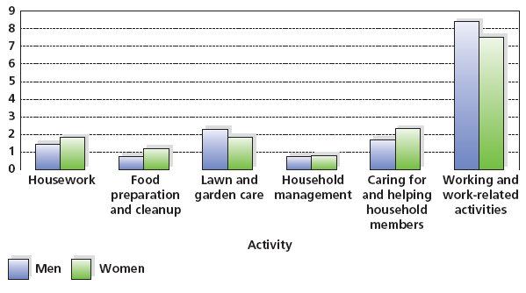
Figure 14-9 Division of Labor
Although husbands and wives generally work at their paying jobs a similar number of hours each week, wives are apt to spend more time than their husbands doing home chores and in child- care activities. Why do you think this pattern exists?
(Source: Bureau of Labor Statistics, 2012.)
Notes:
Note: Figures refer to average hours per day for persons who engaged in the activity.
Close to three-quarters of married women with school-aged children work outside the home.
More than 50% of mothers of children under age 6 work outside home.
In majority of families, both partners work, but wife generally spend more time taking care of the children.
Husbands primarily perform outside chores, and women do housework, child care, meal preparation.
Although husbands and wives work about same number of hours at their paying, women spend more time doing chores and child care tasks.
Women’s household chores tend to be devoted to things that need immediate attention and wives may experience greater levels of anxiety and stress.

Slide 33
The Transition to Parenthood:
Two’s a Couple, Three’s a Crowd?
Having children can well lead to greater marital satisfaction
  at least for couples who are already satisfied with their marriage
For marriages in which satisfaction is low, having children may make a bad situation worse
  Dramatic shift in spouses’ roles
  Challenges to marital satisfaction
  Successful coping
Notes:
Birth of child brings about dramatic shift in spouse’s roles and sometimes decrease in marital satisfaction.
Western culture’s emphasis on individualism views childrearing as primarily private enterprise. Parents in Western society are largely left without significant community support. Consequently, for many couples, strains accompanying the birth of child produce lowest level of marital satisfaction of any point in marriage.
Not all couples experience decrease in marital satisfaction upon birth of child. Factors that permit couples to successfully weather stress of child:
Working to build fondness and affection towards each other.
Remaining aware of events in spouse's life and responding to those events.
Considering challenges controllable and solvable.
Satisfaction closely related to state of marriage before birth of child.

Slide 34
Gay and Lesbian Parents
About 20% of gay men and lesbian women are parents
  No difference in psychological adjustment from children raised in heterosexual homes
  Specialization of roles develop
For children, no differences in terms of eventual adjustment compared to those raised in heterosexual households
Notes:
Compared to heterosexual households, gay and lesbian parents:
Division of household labor
Differential roles
Although both partners usually say they share household tasks and decision-making equally, biological mothers are more involved in child care. Conversely, the nonbiological mother in the couple is more likely to report spending greater time in paid employment.

Slide 35
Staying Single: I Want to Be Alone
About 20 percent of women and 30 percent of men live alone without an intimate partner
About 20 percent overall will live their entire lives in singlehood
Often due to:
Negative views of marriage
Seeing marriage as too restrictive
Lack of a suitable partner
Notes:
About 20% of women and 30% of men in U.S. choose singlehood, living alone without partner for varying reasons:
View marriage as negative
View marriage as restrictive
Don't find anyone they want to spend the rest of their lives with.
Value independence, autonomy, and freedom.
Society stigmatizes single individuals, particularly women.

Slide 36
Work: Choosing and Embarking on a Career
14.10 Explain the role of careers in the lives of young adults.
14.11 List factors that influence the choice of a career in early adulthood.
14.12 Describe how gender affects work choices and the work environment.
14.13 Explain why people work and what elements of a job bring satisfaction.

Slide 37
Identity During Young Adulthood:
The Role of Work
Career consolidation
General pattern of psychological development as young adults center on careers
Career concerns supplant focus on intimacy
Criticisms
Highly restricted sample limits generalizability
Dated findings in view of shifts in attitudes toward importance of work
Notes:
Career Consolidation – stage that begins between ages of 20 and 40, in which young adults become centered on careers.
According to Vaillant, people work hard to advance in their jobs, and career focus supplants personal intimacy as a bridge between Erikson’s intimacy and generativity stages.
Vaillant only studied men.

Slide 38
Picking an Occupation:
Career Choice Theory
Ginzberg’s Approach
Fantasy period
Tentative period
Realistic period
Criticism
Non-representative sample
Overstates choices and options to lower SES people
Age demarcations may be too rigid
Notes:
Ginzberg’s Career Choice Theory holds that people move through series of stages in choosing career:
Fantasy period – Lasts until 11 years old. Career choices are made without regard to skills, abilities, or available jobs.
Tentative period – During adolescence, begin to think about job requirements and how their abilities and interests fit them.
Realistic period – Young adults explore specific career options through actual experience or through training for a profession.
Critics say this theory oversimplifies career choice process.

Slide 39
Picking an Occupation:
Personality Types
Holland’s Approach
Realistic
Intellectual
Social
Conventional
Enterprising
Artistic
Criticisms
Lack of fit for many
Exceptions to typology
Notes:
Holland’s Personality Type Theory holds that certain personality types match certain careers.
Six types:
Realistic
Intellectual
Social
Conventional
Enterprising
Artistic

Slide 40
Gender and Career Choices:
Women’s Work
Traditionally:
  Communal professions were seen as appropriate for women
  Agentic professions were seen as appropriate for men
Women less likely to be found in male-dominated professions
Notes:
Today women’s options for careers are unlimited. It has not always been that way.
Traditionally, women were considered most appropriate for Communal Profession, associated with relationships (like teachers) and men were thought to be better at Agentic Professions (getting things accomplished).
Today, women are less likely to be found in male-dominated professions like engineering and computer programming.
Women’s wages still lag behind those of men, even though opportunities are greater.
Women seem to hit the “glass ceiling,” an invisible barrier that prevents promotions beyond a certain level.

Slide 41
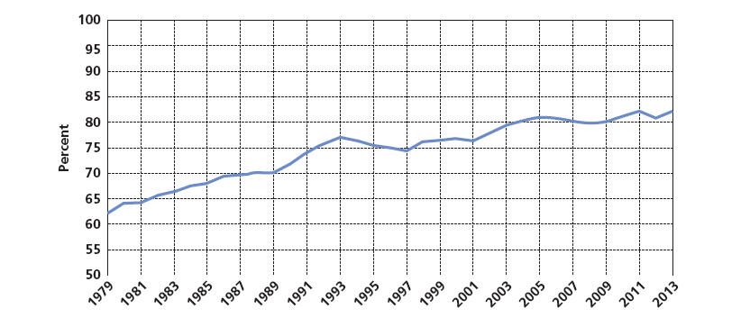
Figure 14-10 The Gender Wage Gap
Women’s weekly earnings as a percentage of men’s have increased since 1979 but are still only a bit more than 75 percent.
Notes:
See Facts About Working Women (http://www.womenemployed.org/docs/Facts%20about%20Working%20Women.pdf). This is a good class resource.
More women are working outside the home than ever before despite status and pay that are often lower than men's.
Between 1950 and 2003, the percent of the female population (aged 16 and over) in the U.S. labor force increased from around 35 percent to over 60 percent, and women today make up around 55 percent of the labor force, a figure comparable to their presence in the general population.
Almost all women expect to earn living, and almost all do at some point in their lives. Furthermore, in about one-half of U.S. households, women earn about as much as their husbands.
Wages still lag behind those of men.
“Glass ceiling”

Slide 42
Why Do People Work?
More Than Earning a Living
Motivation
  Extrinsic
  Intrinsic
Personal identity
Status
Notes:
Intrinsic and Extrinsic Motivation
Extrinsic Motivation drives people to obtain tangible rewards, such as money and prestige.
Intrinsic Motivation drives people to work for its own reward.
Sense of personal identity.
Central element in one's social life.
Work is factor in determining Status, the evaluation by society of role person plays.

Slide 43
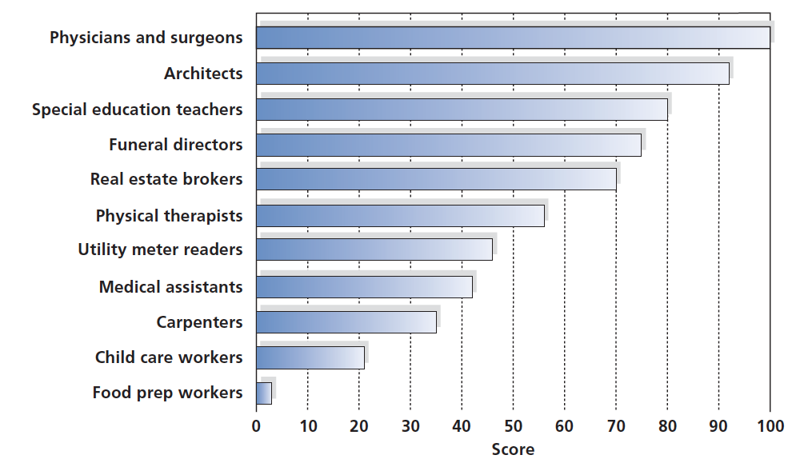
Figure 14-11 Status Hierarchy of Various Professions
Notes:
(Source: Based on Nam and Boyd, 2004.)

Slide 44
Satisfaction on the Job
Satisfaction related to job status
Worker satisfaction also associated with:
  Nature of job
  Amount of input one has into one’s duties
  Influence employees have over others
Notes:
Higher status of job, more satisfied people tend to be.
Status of job of major wage-earner can affect status of other members of family Satisfaction associated with job status.
Status isn’t everything. Worker satisfaction associated with:
Nature of job
Amount of input one has into one’s duties
Influence employees have other others

Slide 45

Copyright

